Slide 1

Diversity in Amphibians Across the United States
BIO860: Data for the Life Sciences
Hannah Hagearty

Slide 2
Why is Diversity in Amphibians Important?
Diversity of the organisms within an ecosystem is indicative of a healthy and balanced environment.
(US EPA, “Diversity and Biological Balance.”)
Amphibians are indicator species; their skin is very sensitive and they are often the first affected by atmospheric change and pollution.
(West, “Importance of Amphibians: A Synthesis of Their Environmental Functions, Benefits to Humans, and Need for Conservation.”)
The National Parks are important in the conservation and characterization of amphibian species across their managed parks and facilities. – Logged in the NPSpecies System.
(Halstead et al., “Looking Ahead, Guided by the Past.”)
The dataset being analyzed in the following review seeks to better understand what sort of amphibian diversity is present in parks today, and characterize and compare diversity by state.
(LaFrance et al., “A Dataset of Amphibian Species in U.S. National Parks.”)

Slide 3
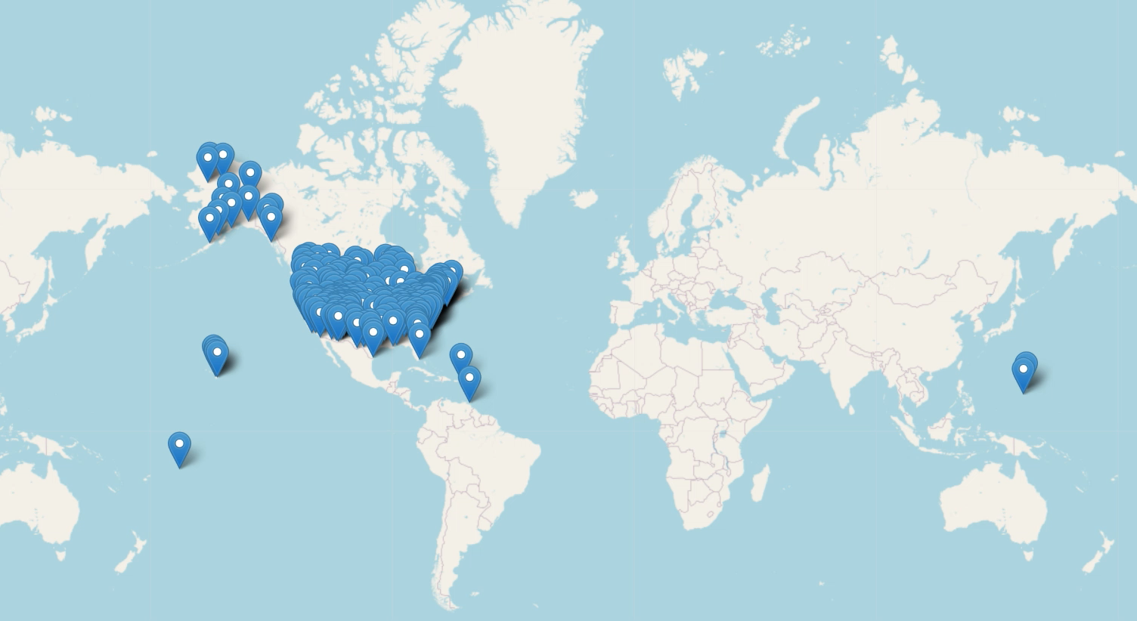
Sampling Locations
file:///C:/Users/hagea/OneDrive/Documents/Fall%202024%20-%20Spring%202025/Data%20for%20the%20Life%20Sciences/Labs/Final%20Project/New%20Amphibians/interactivemap.html

Slide 4
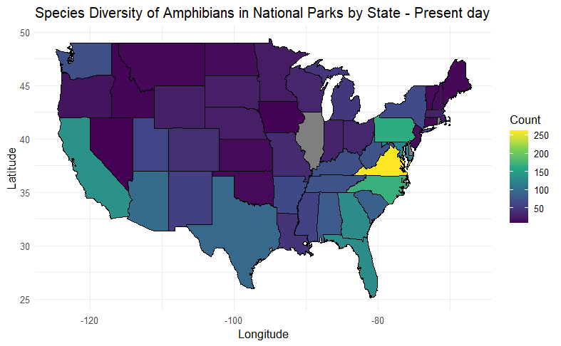
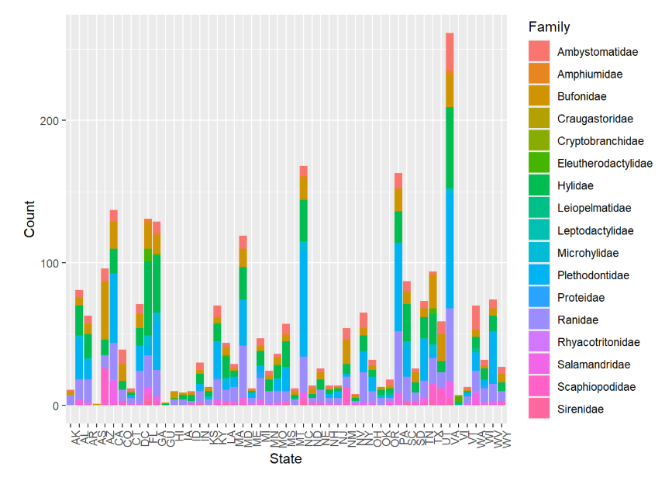
Species and Family Diversity by State

Slide 5
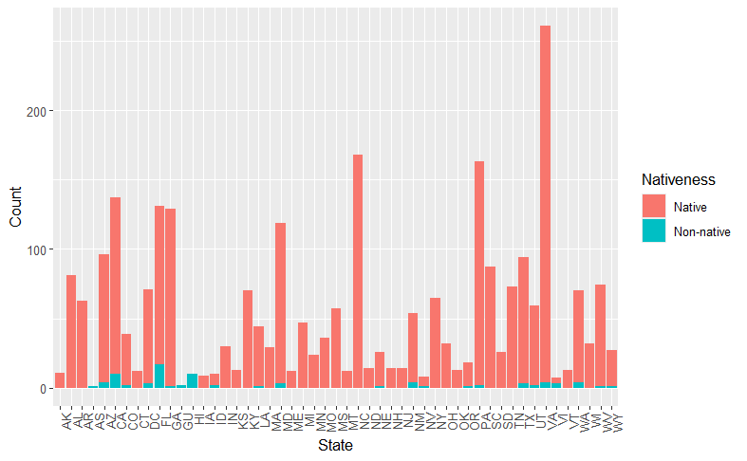
Distribution of Native and Non-native Amphibians by State
Two Sample t-test
data: count by Nativeness
t = 4.8695, df = 70, p-value = 6.692e-06
alternative hypothesis: true difference in means between group Native and group Non-native is not equal to 0
95 percent confidence interval:
30.23449 72.18217
sample estimates:
mean in group Native mean in group Non-native
54.666667 3.458333

Slide 6
References
Cambon, Jesse, Diego Hernangómez, Christopher Belanger, and Daniel Possenriede. 2021. “Tidygeocoder: An r Package for Geocoding.” Journal of Open Source Software 6 (65): 3544. https://doi.org/10.21105/joss.03544.
Cheng, Joe, Barret Schloerke, Bhaskar Karambelkar, and Yihui Xie. 2024. Leaflet: Create Interactive Web Maps with the JavaScript ’Leaflet’ Library. https://CRAN.R-project.org/package=leaflet.
Halstead, Brian J., Andrew M. Ray, Erin Muths, Evan H. Campbell Grant, Rob Grasso, Michael J. Adams, Kathleen Semple Delaney, Jane Carlson, and Blake R. Hossack. 2022. “Looking Ahead, Guided by the Past: The Role of U.S. National Parks in Amphibian Research and Conservation.” Ecological Indicators 136 (March): 108631. https://doi.org/10.1016/j.ecolind.2022.108631.
Hayes, T. B., P. Falso, S. Gallipeau, and M. Stice. 2010. “The Cause of Global Amphibian Declines: A Developmental Endocrinologist’s Perspective.” The Journal of Experimental Biology 213 (6): 921–33. https://doi.org/10.1242/jeb.040865.
“Integrated Taxonomic Information System.” n.d. https://www.itis.gov/.
LaFrance, Benjamin J., Andrew M. Ray, Robert N. Fisher, Evan H. Campbell Grant, Charles Shafer, David A. Beamer, Stephen F. Spear, et al. 2024a. “A Dataset of Amphibian Species in U.S. National Parks.” Scientific Data 11 (1): 32. https://doi.org/10.1038/s41597-023-02836-2.
———, et al. 2024b. “A Dataset of Amphibian Species in U.S. National Parks.” Scientific Data 11 (1): 32. https://doi.org/10.1038/s41597-023-02836-2.
———, et al. 2024c. “A Dataset of Amphibian Species in U.S. National Parks.” Scientific Data 11 (1): 32. https://doi.org/10.1038/s41597-023-02836-2.
“NatureServe Explorer.” n.d. https://explorer.natureserve.org/.
“NPSpecies- Welcome to NPSpecies.” n.d. https://irma.nps.gov/NPSpecies/.
R Core Team. 2024. R: A Language and Environment for Statistical Computing. Vienna, Austria: R Foundation for Statistical Computing. https://www.R-project.org/.
“T-Test, Chi-Square, ANOVA, Regression, Correlation...” n.d. https://datatab.net/tutorial/t-test.
US EPA, ORD. 2015. “Ecoregions of North America.” https://www.epa.gov/eco-research/ecoregions-north-america.
———. 2017. “Diversity and Biological Balance.” https://www.epa.gov/report-environment/diversity-and-biological-balance.
West, Josh. n.d. “Importance of Amphibians: A Synthesis of Their Environmental Functions, Benefits to Humans, and Need for Conservation.”

